Slide 1
DAY 4: AI AS AN ARTIST – GENERATIVE ART
How AI Creates Cool Art and Images

Slide 2
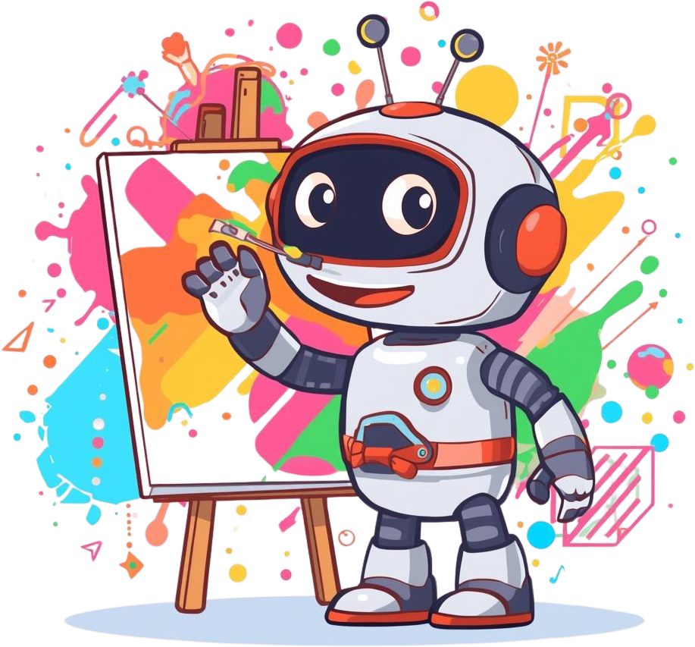

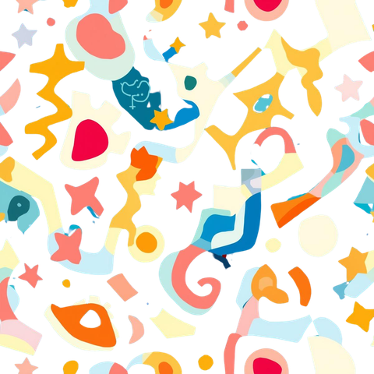
AI Artist
WHAT IS GENERATIVE ART?
Art Made by Computers!
Generative art is art made by computers using special programs called AI. The AI uses rules and creativity to make pictures, music, or stories! It's like having a robot friend who loves to paint, draw, and create amazing things with you!

Slide 3
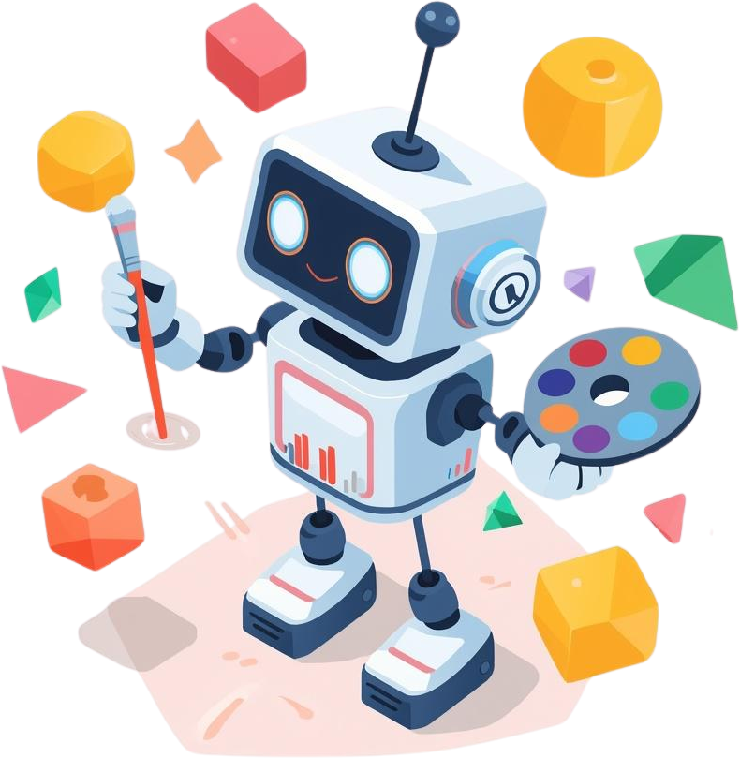
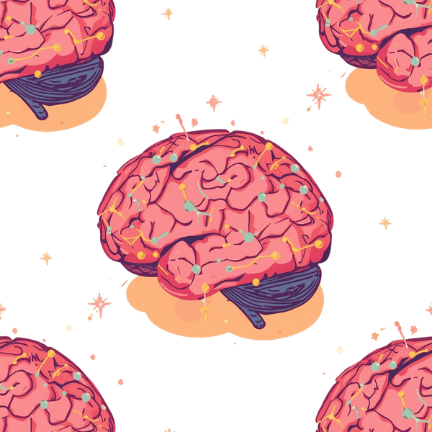
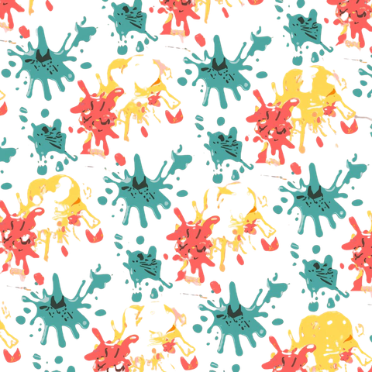
AI Art Studio
HOW DOES AI MAKE ART?
Easy Steps to AI Art!
AI learns from many pictures or artworks
It finds patterns and styles in them
AI mixes these ideas to create new images
The result is unique art made by the computer!
Every AI artwork is one-of-a-kind!
You can guide AI with your ideas!

Slide 4
COOL AI ART YOU KNOW!
AI Art Generators
Fun Filters
Apps like Snapchat and Instagram use AI to add cool effects to your photos!
Websites and apps that turn your words into amazing pictures! Just type what you imagine!
Creative Apps
Games & Movies
AI creates amazing images in your favorite video games and animated movies!
Tools that help you draw and paint with AI as your creative helper!

Slide 5
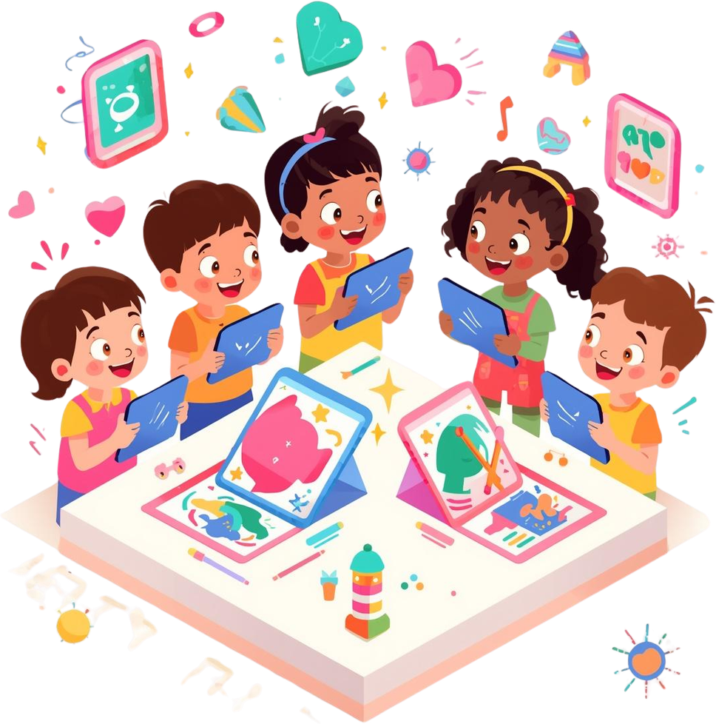
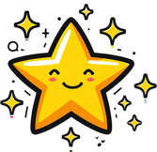
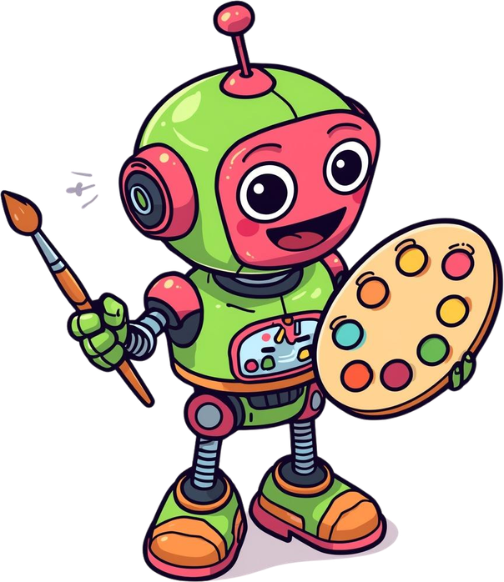
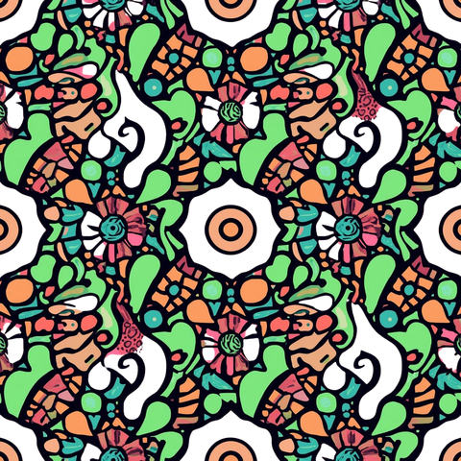
Your Turn!
WHAT KIND OF ART WOULD YOU LIKE AI TO CREATE?
Try an AI art app or filter at home and see what you can make! AI can help you be an artist too! Get creative and share your AI art with friends!

